Slide 1

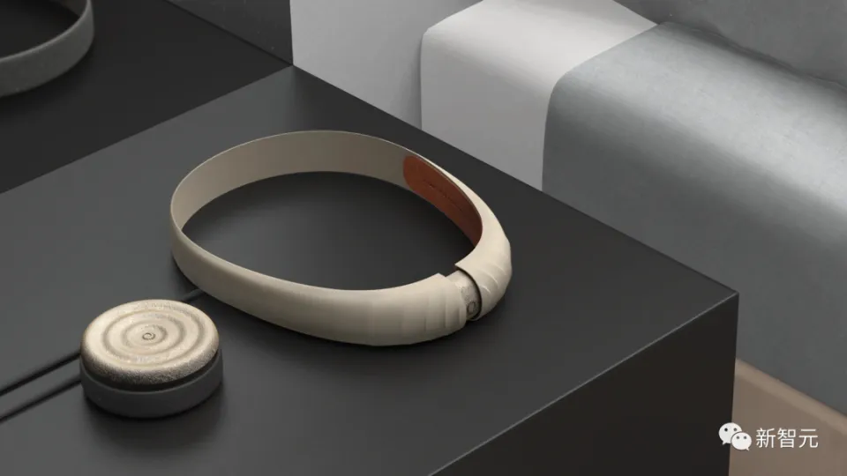
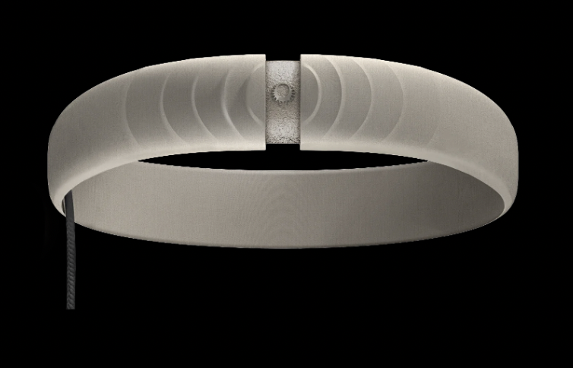

Prophetic AI: An Introduction
By Michael Zhou, 6/16/2024

Slide 2
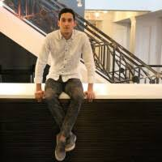


About the Company
Eric Wollberg, CEO
Neurotechnology company for inventing wearable devices for stabilizing lucid dreams
Based in New York City
Founded by Eric Wollberg and Wesley Berry in March 2023
Raised $1.1M in funding led by VC firm BoxGroup
Partnered with Card79 (known for making hardware for Elon Musk’s Neuralink) and Donders Sleep & Memory Lab (for collecting data from subjects + experiementation)
Known for developing the world’s first multi-modal generative ultrasonic transformer, Morpheus-1

Slide 3
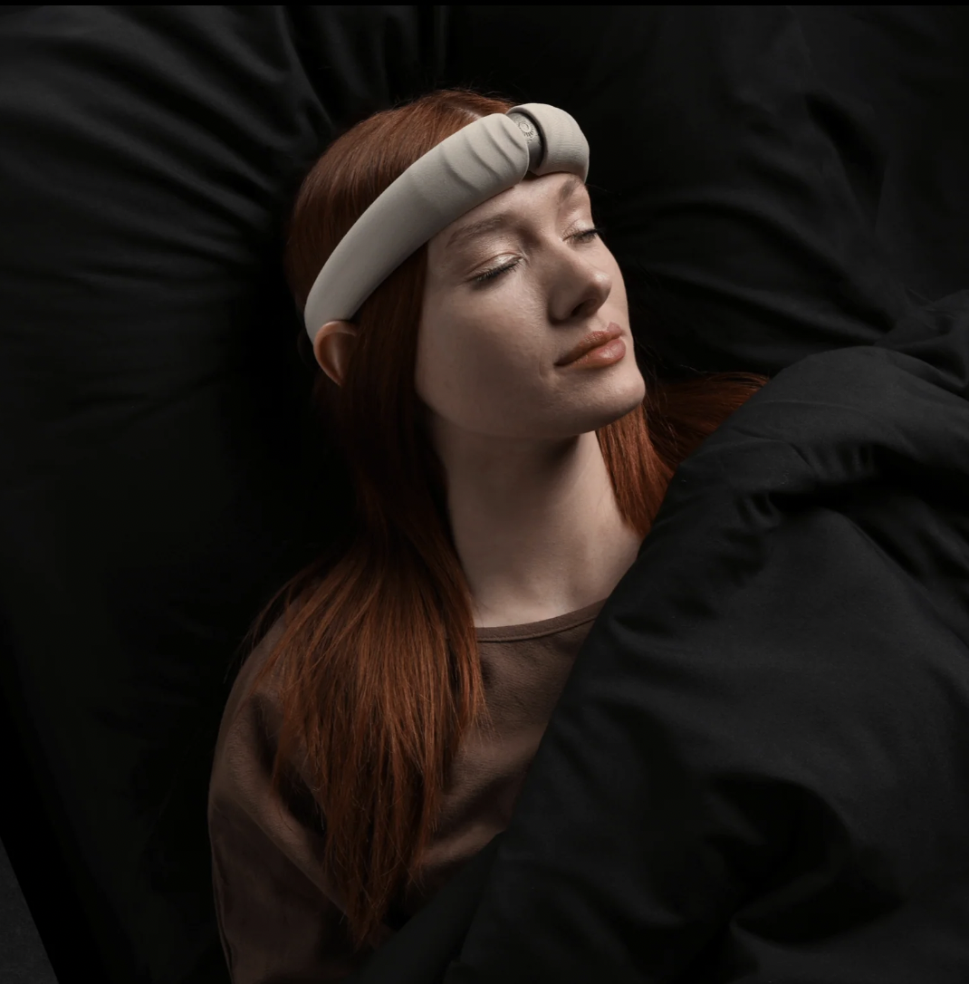
What are Lucid Dreams?
Dreams where the dreamer is aware while asleep
Dreamer can exert control over their dream by changing the characters, narrative, or environment
Includes little to no sensory input
Excellent for creative problem solving - dreamer is freed from conventional laws of physics: gravity, conservation of energy & mass
Can construct and explore extraordinary environments, speak to dream characters, and/or fly

Slide 4
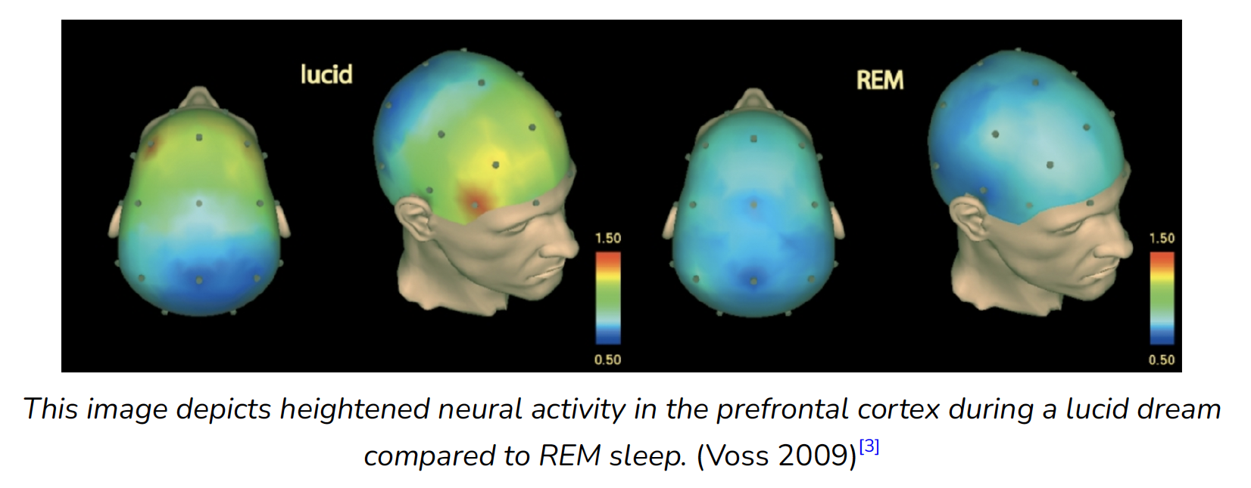
Lucid Dreams: Prefrontal Cortex Activation
Prefrontal cortex – associated with self-awareness & decision-making
Regular dream (rapid-eye movement, or REM) – prefrontal cortex less active
Lucid dream – prefrontal cortex “wakes up” (allowing users to realize they are dreaming)

Slide 5
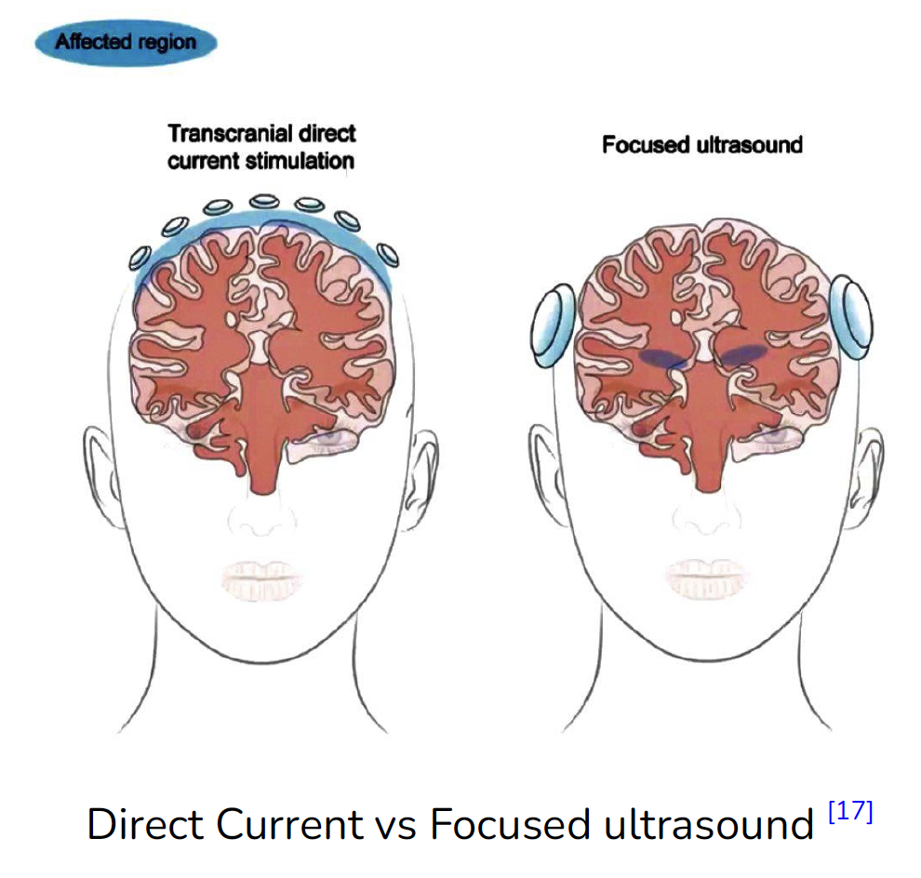
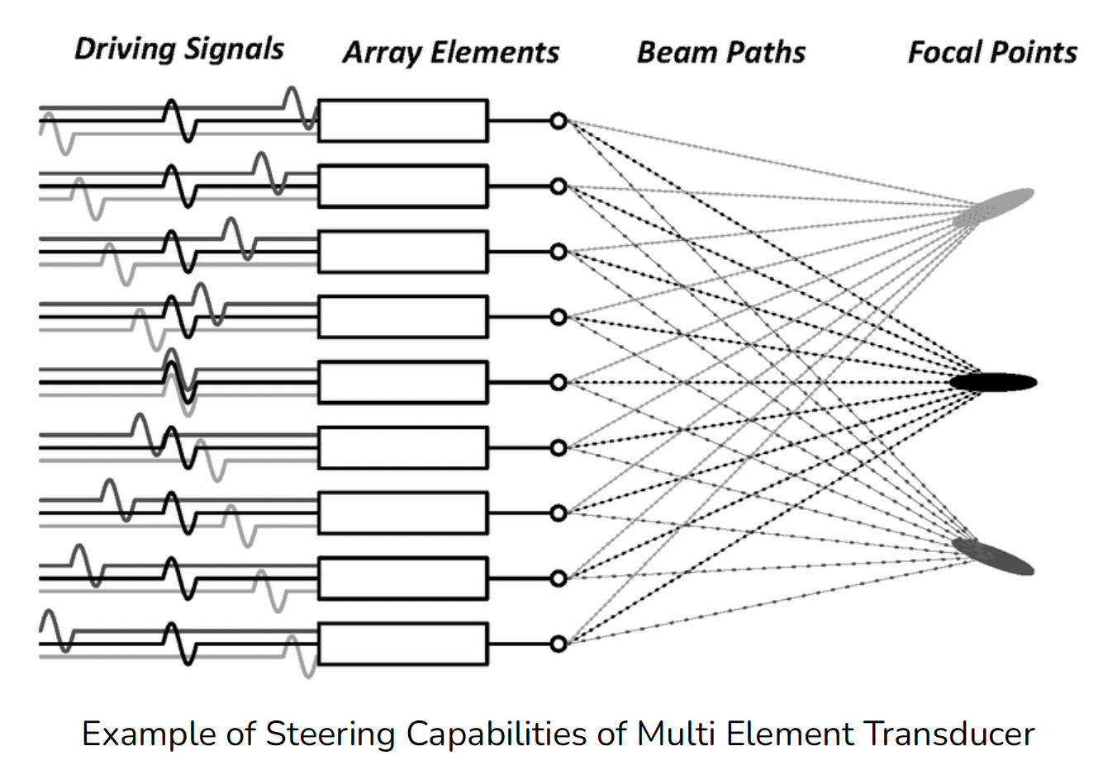
Transcranial Focused Ultrasound (tFUS)
Uses ultrasound waves to non-invasively modulate neural activity – aim sound waves through cranium to specific focal points in brain that are statistically significant
Millimeter precision (multiple orders of magnitude improvement over tDCS)
Reduced Spread – Focused on desired brain region, minimized off-target effects
3D Steering – use multi-element tranducers to steer ultrasonic beam without moving transducer
Modulation pulses occur in sequential spatial patterns (rather than single fixed location)
Depth of Penetration – ultrasound waves penetrate & modulate deeper brain structures (as well as superficial brain regions, in tDCS)
Repeatedly shown safe & beneficial - working memory shows significant improvement (working memory impaired during regular dream)

Slide 6
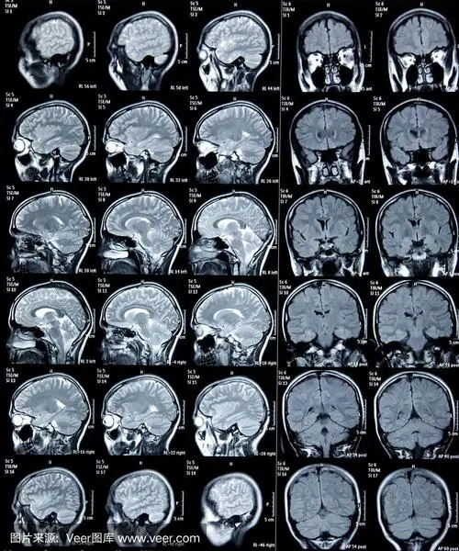
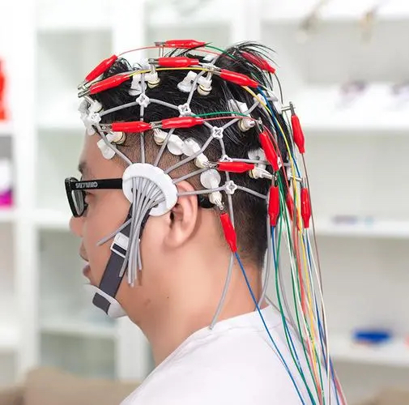
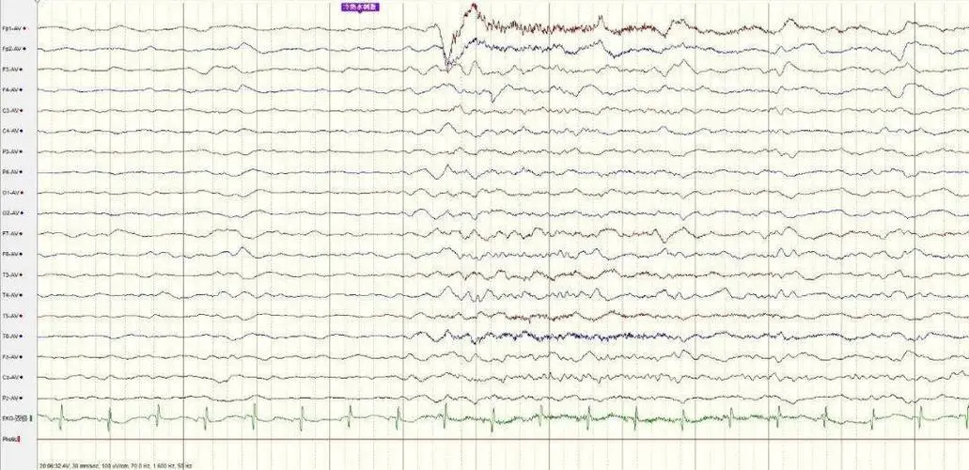
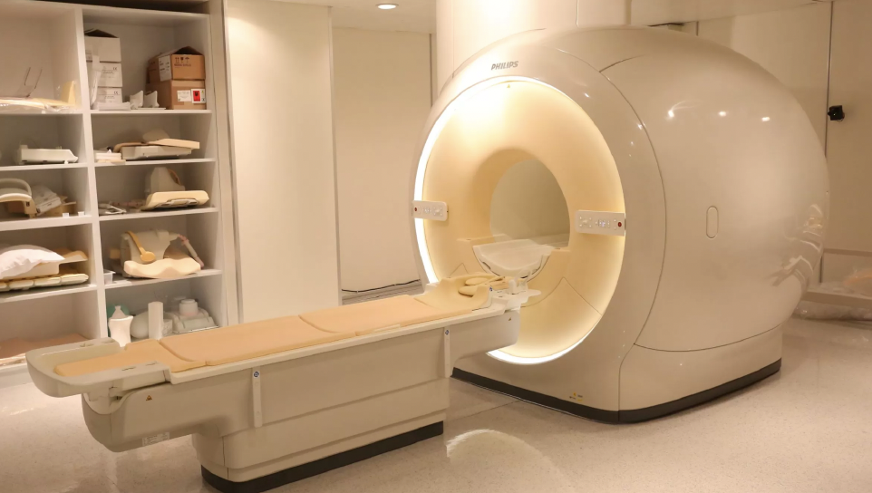
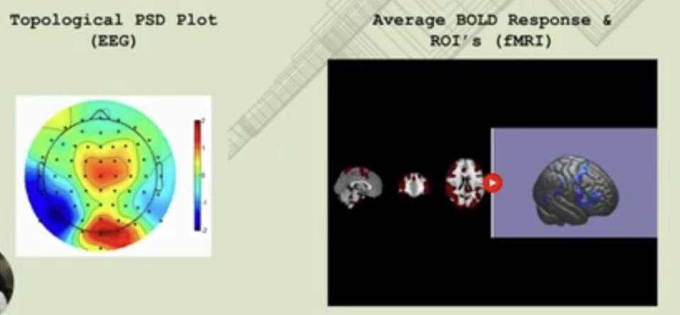
EEG vs fMRI
EEG (Electroencephalography)
Measures electrical activity in brain
Placed on scalp to detect voltage fluctuations from ionic current flows within neurons
High temporal resolution (captures changes in brain activity in milliseconds)
Low spatial resolution (summation of electrical activity from large # of neurons, cannot pinpoint exact location in brain)
Non-invasive, relatively inexpensive, portable
fMRI (Functional Magnetic Resonance Imaging)
Measures blood flow changes in brain
Relies on BOLD (Blood Oxygen Level Dependent) contrast – changes in concentration of oxygenated & deoxygenated blood in brain
Low temporal resolution (captures images every 1-2 seconds)
High spatial resolution (detailed brain structures in order of millimeters)
Non-invasive, but very expensive, highly sensitive to movement
* ROI: region of interest

Slide 7
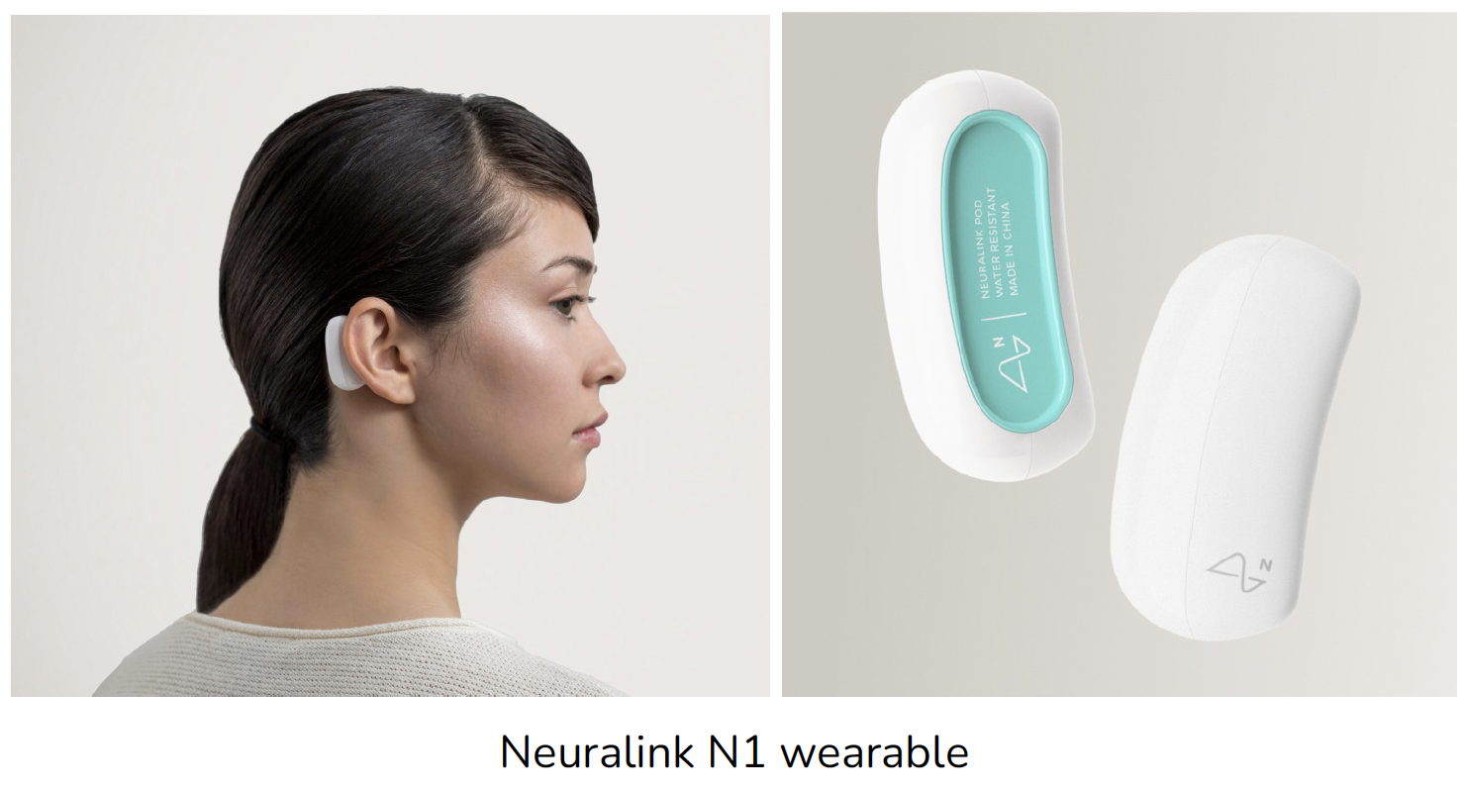
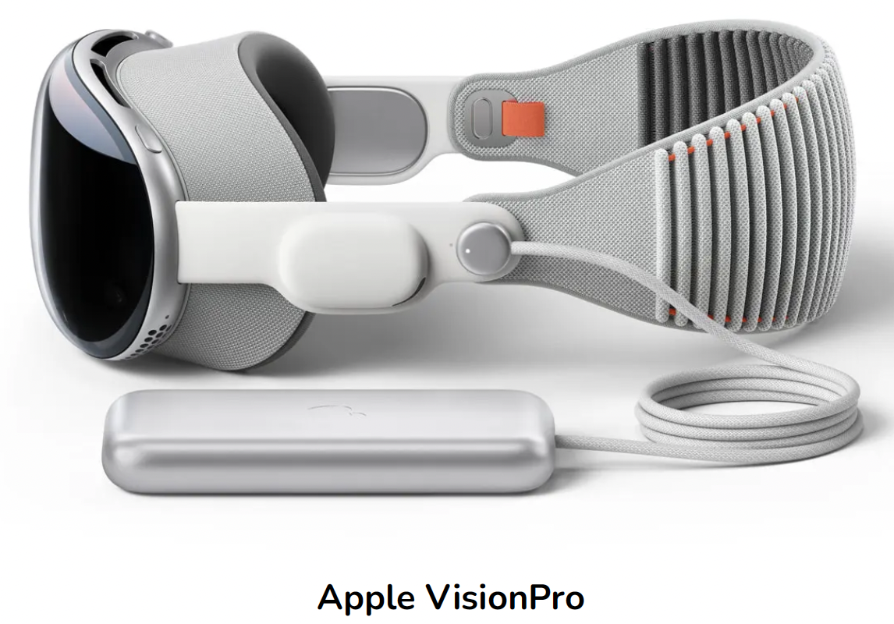
Product: The Halo
Artificially recreates brain’s frontal activity
Closed-loop, non-invasive neurostimulation device to induce and stabilize lucid dreams via EEG and transcranial focused ultrasound (tFUS) stimulation
Uses AI methods for EEG feedback to spatially generate ultrasonic pulses, mimicking natural neural activation patterns from fMRI training data
Designed by Afshin Mehin’s team (also designed Neuralink N1 in 2019)
Prototyping advised by Sterling Crispin (ex-Apple VisionPro Neurotechnology Prototyping Researcher)

Slide 8
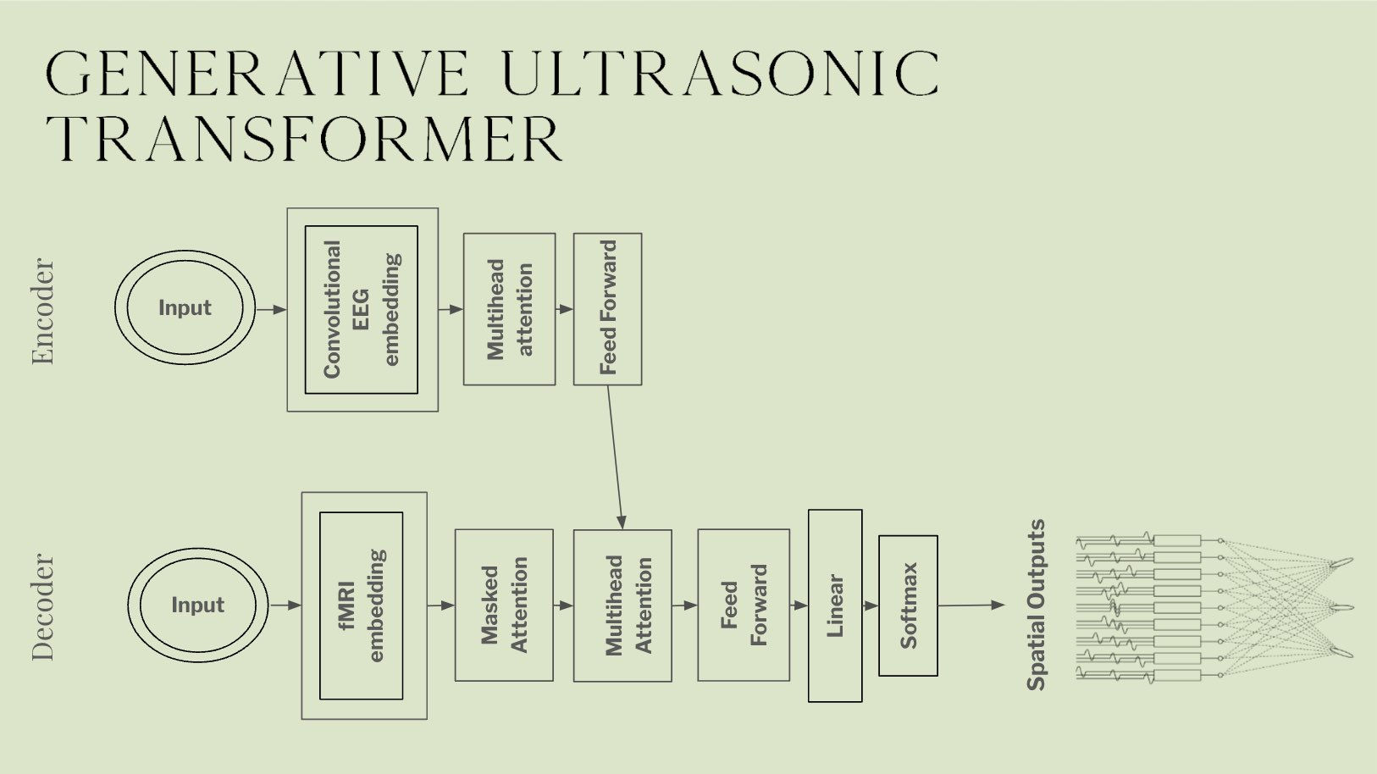
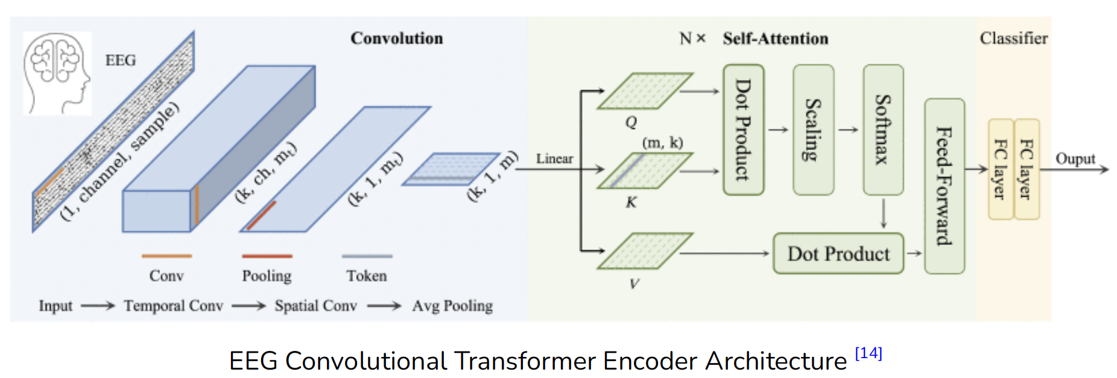
Model: Morpheus-1
World’s first multi-modal generative ultrasonic transformer to stabilize and induce lucid dreams
Prompted via brain states (EEG + fMRI data)
EEG data – input to encoder
fMRI data – input to decoder
Generates ultrasonic holograms (spatial outputs) for neurostimulation to induce lucid brain states
Uses 3D steering and Acoustic Holography
103M-parameter transformer trained on 8 GPUs over 2 days
Example implementation available on Github

Slide 9

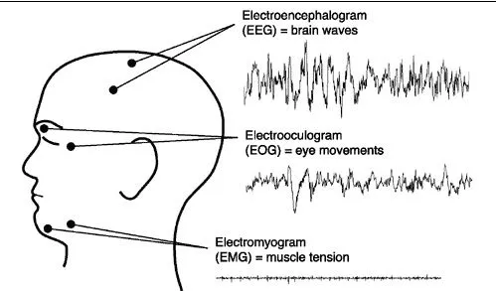
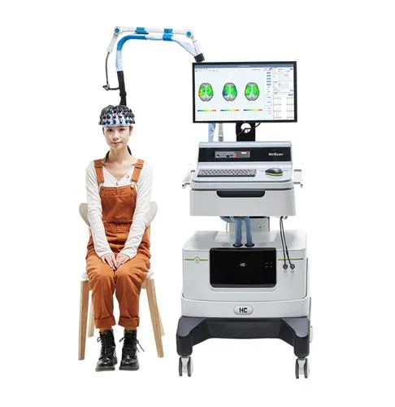
Experiments
Partnership with Donders Institute for Cognitive Neuroimaging (Radboud University, Netherlands)
Collect largest dataset of simultaneous normalized EEG-fMRI imaging data of lucid dreamers
Neuroimaging – 100 lucid dreamers scanned with 3 Tesla structural & functional MRI, 32 channel polysomnography (EEG, EOG, EMG), and functional near-infrared spectroscopy (fNIRS)
Transcranial focused ultrasound (tFUS)
30 participants recorded with multi-channel polysomnography while undergoing tFUS during sleep
Imaged via fMRI pre-sleep & post-sleep
Targets: Angular Cingulate Cortex, Frontal Forebrain, Frontopolar Cortex
Focus on neural correlates of lucid dreaming & development + validation of strategies for inducing lucid dreaming

Slide 10
Safety, Privacy, and Ethics
Safety – system must undergo rigorous testing to ensure no negative side-effects on brain function or physical harm
Ultrasonic stimulation system with spatial-peak temporal average (ISPTA) and spatial-peak pulse average (ISPPA) below FDA regulations for diagnostic ultrasound
Fail-safe mechanisms to ensure above values cannot be exceeded by any circumstance
Privacy/Ethics – Strong ethical guidelines ensure users maintain control over their dreams without intrusion of personal and subconscious mind
Inducing lucid dreams via tFUS could lead to manipulative practices (propaganda, advertising, scamming, etc.)
Should be strictly used for facilitating lucidity to give dreamers control of their dream experiences, respecting user’s cognitive autonomy

Slide 11

Company Website
https://propheticai.co/

Slide 12

“Prometheus stole fire from the Gods……we will steal dreams from the Prophets” --Eric Wollberg, CEO of Prophetic AI

